Slide 1
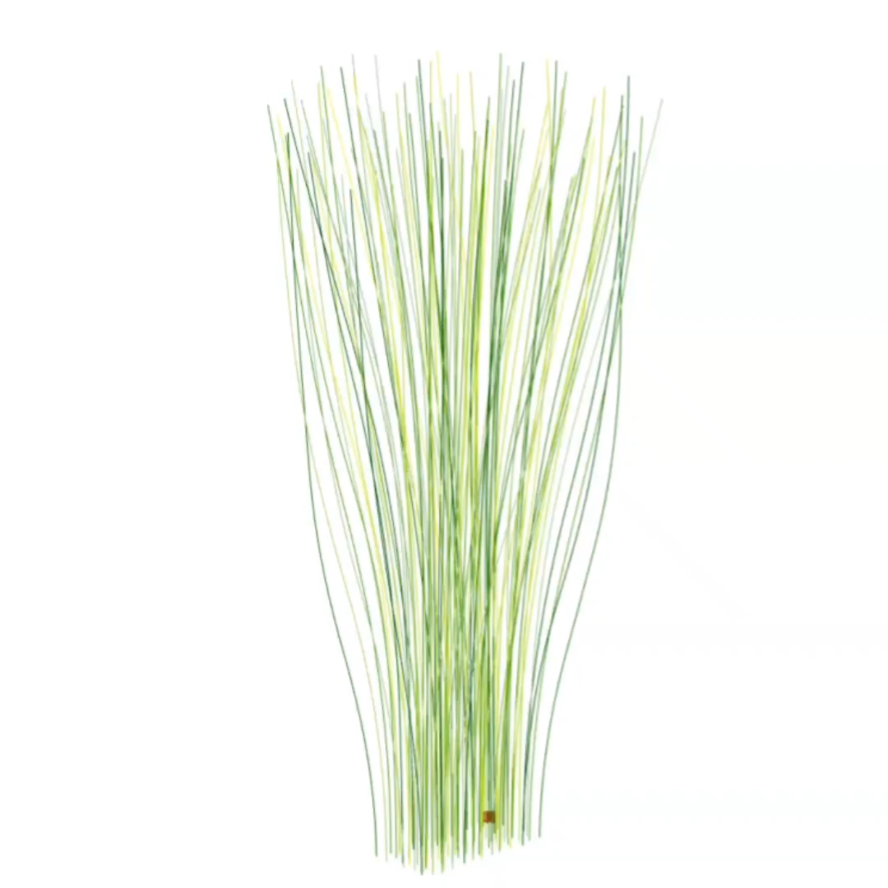
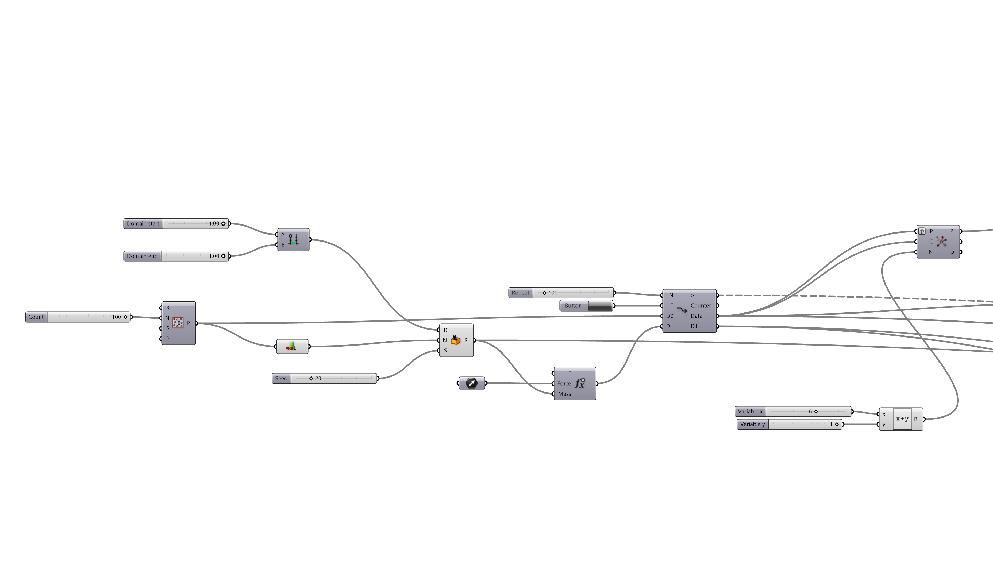
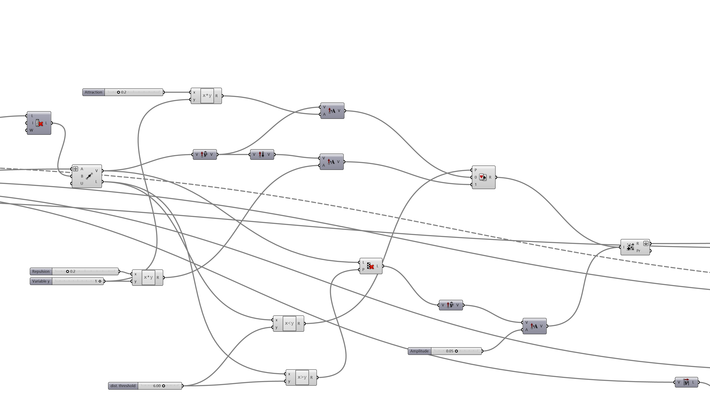

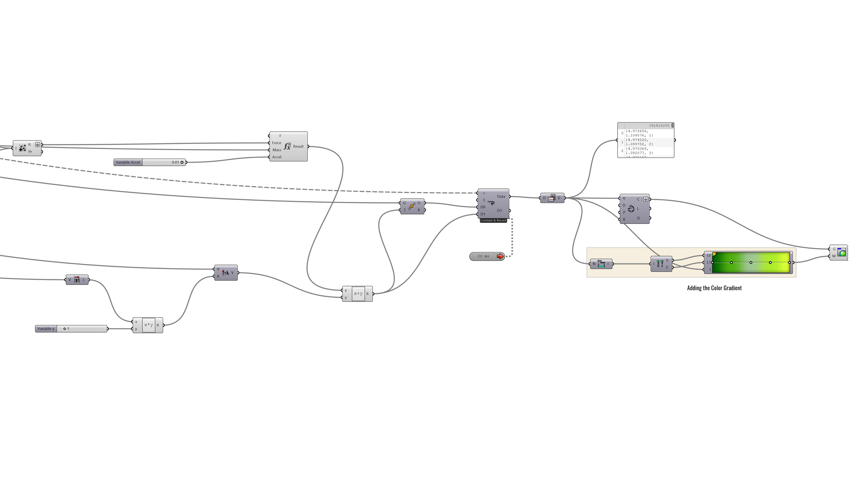
Workout [3] - Curve Manipulation (Goal: Swarming)
Supporting Tutorial (YouTube): Ace Design Institute, “Using Real-Life Physics Law and the ‘Anemone’ Plugin
Part – 1
Selecting Closest Points
Loop Start (Anemone)
Random Point Generation
Algorithm for Data Manipulation
Part – 2
Generating Vectors
Defining Amplitude
Inspiration: Bamboo
Picking from Data
Part – 3
Algorithm for Data Manipulation
Loop End (Anemone)
Adding a Color Gradient

Slide 2
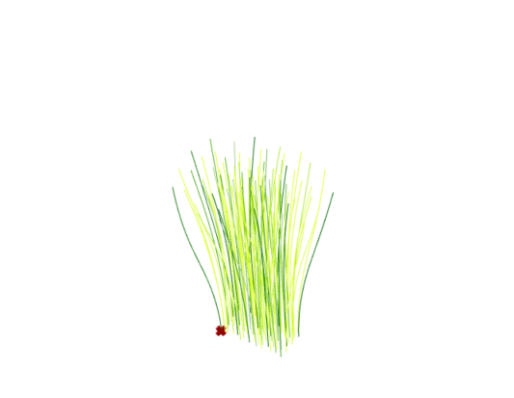
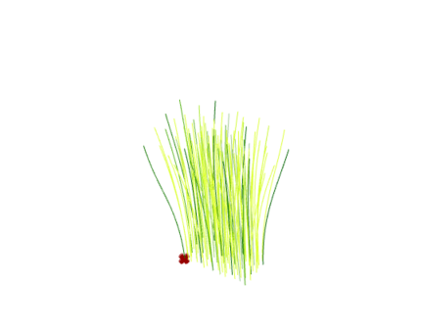
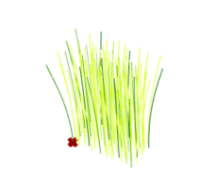
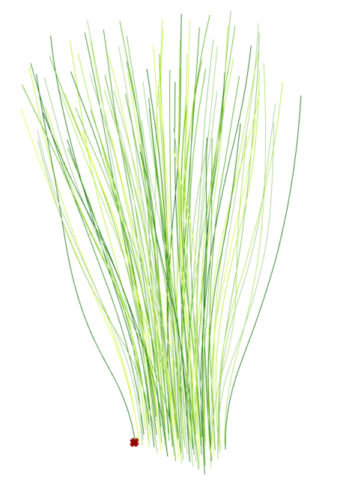
Workout [3] - Curve Manipulation (Goal: Swarming)
Supporting Tutorial (YouTube): Ace Design Institute, “Using Real-Life Physics Law and the ‘Anemone’ Plugin
2 Sec
4 Sec
6 Sec
Part – 1
Selecting Closest Points
Loop Start (Anemone)
Random Point Generation
Algorithm for Data Manipulation
Part – 2
Generating Vectors
Defining Amplitude
10 Sec
Inspiration: Bamboo
Picking from Data
Part – 3
Algorithm for Data Manipulation
Loop End (Anemone)
Adding a Color Gradient

